Slide 1

Introduction to Computing for AI and ML (ICAIML): DA-203-O
A Comprehensive ML Framework for Data Wrangling and Exploratory Analysis
ML Init
Ajith Kumar K (ajithkumark@iisc.ac.in), Jamsheed M P (jamsheedm@iisc.ac.in)
Shilpa Singh (shilpasingh@iisc.ac.in), Sourabh Gothe Vasant (sourabhgothe@iisc.ac.in)

Slide 2
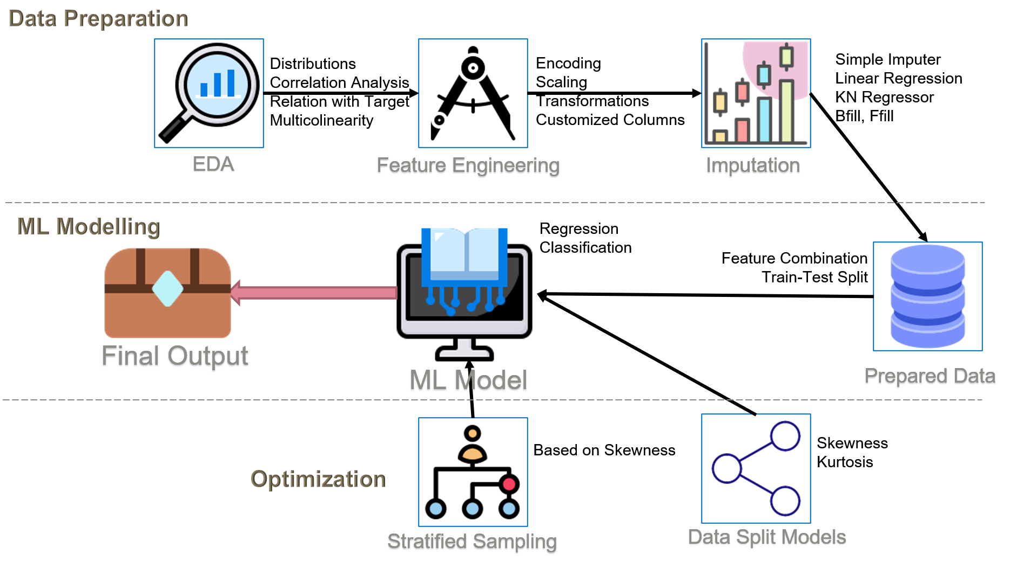
Why do we need ML Init?
ML Init
Data preparation is the vital step of the ML process cycle. It consists of loading the dataset, identifying the features and their distributions, handling missing data points, analyzing skewness, etc. and is the most repetitive and time-consuming task.

Slide 3
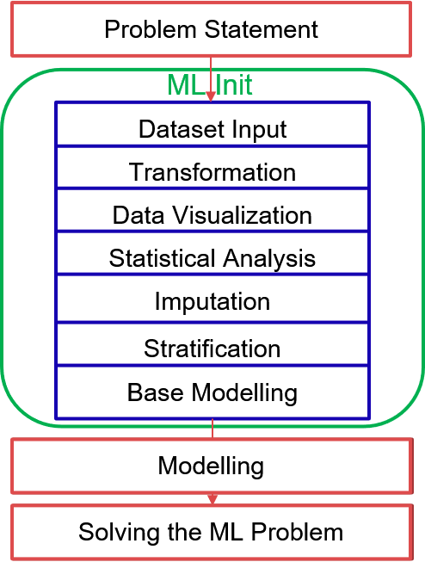
What is ML Init??
ML Init
MLInit is a comprehensive python-notebook based framework for data wrangling and exploratory analysis.
It provides an easy to use ipywidget based GUI Interface to input the data, label and for customizations
Automatically Identifies the type of problem (regression/classification), type of features(numerical/categorical), clean data via regex and transforms data.
Visualizes data in various forms for effective EDA
Detects skewness in data distribution, performs multicollinearity checks, dimensionality reduction test and also provides missing datapoints report.
Performs imputation based on various methods like KNN, Bfill/Ffill, iterative, simple imputation and most frequent class
Performs stratification based on top correlated features and reports reduction in error in comparison to random split
Performs modelling suggestion based on regression, classification problem type and allows user to tune the model hyper parameters and train.
Reports accuracy via R2, RMSE for regression and F1, AUC for classification
Notes:
Dataset Input - Users can upload dataset or select already uploaded data set, choose the target feature, Tool auto detects type of problem and classifies the features in to numerical/categorical, user can also choose unwanted features.
Transformation – Dataset cleaning and type of data detection via regex and perform datatype conversions
Data visualization – Automatically provides and saves histograms, count plot, box plot, distribution Vs target bar plot, correlational analysis plot, QQ plot, Mutual information etc.
Statistical Analysis – Find distribution of data, performs multicollinearity checks, dimensionality reduction test and provide missing datapoints report
Imputation – Users input based imputation numerical –KNN, Iterative, simple(mean, median) and Window, categorical-KNN and Replace with most frequent class, user can also choose to drop missing data-points
Stratification - Performs a stratified split and reports the error reduction achieved compared to a random split based on user choice of top correlated features.
Base Modelling - Performs basic modelling suggestion based on regression, classification problem type by initially encoding, scaling the feature set and based on user selection of model and parameter tuning, reporting accuracy via R2, RMSE for regression and F1, AUC for classification

Slide 4
How is ML Init different?
ML Init
MLInit | Other tools
No Additional installations, setup, it can run directly on colab/jupyter | Need to install the tool, very few tools available in python.
Auto detect the type of problem, type of features and perform automatic visualizations | Visualizations are not automatic, user needs to provide information required for visualizations
Performs Feature distribution analysis(skewed, uniform or normal), multi-collinearity test, dimensionality reduction test and provide user-driven insights. | We didn’t come across such functionality in other tools
Stratification on top correlated features and report the error reduction in comparison to random split
Automatic data cleaning, data type conversions and imputation based on various methods
Notes:
Existing open source are in R, Java, c++ or even in pascal, only orange is in python But orange was updated long time back and it requires the understanding of orange widgets framework If we contribute to it will be more of learning the custom GUI framework rather than the applying our learnings from the course

Slide 5
ML Init
Thank You !
Ajith Kumar K (ajithkumark@iisc.ac.in)
Jamsheed M P (jamsheedm@iisc.ac.in)
Shilpa Singh (shilpasingh@iisc.ac.in)
Sourabh Gothe Vasant (sourabhgothe@iisc.ac.in)

